Slide 1
Chapter Six
Errors, Error Detection, and Error Control
Data Communications and Computer Networks: A Business User’s Approach
Eighth Edition
© 2016. Cengage Learning. All Rights Reserved.

Slide 2
After reading this chapter, you should be able to:
Identify the different types of noise commonly found in computer networks
Specify the different error-prevention techniques, and be able to apply an error-prevention technique to a type of noise
Compare the different error-detection techniques in terms of efficiency and efficacy
Perform simple parity and longitudinal parity calculations, and enumerate their strengths and weaknesses
Data Communications and Computer Networks: A Business User's Approach, Eighth Edition
© 2016. Cengage Learning. All Rights Reserved.

Slide 3
After reading this chapter, you should be able to (continued):
Cite the advantages of arithmetic checksum
Cite the advantages of cyclic redundancy checksum, and specify what types of errors cyclic redundancy checksum will detect
Differentiate between the basic forms of error control, and describe the circumstances under which each may be used
Follow an example of a Hamming self-correcting code
Data Communications and Computer Networks: A Business User's Approach, Eighth Edition
© 2016. Cengage Learning. All Rights Reserved.

Slide 4
Introduction
Noise is always present
If a communications line experiences too much noise, the signal will be lost or corrupted
Communication systems should check for transmission errors
Once an error is detected, a system may perform some action
Some systems perform no error control, but simply let the data in error be discarded
Data Communications and Computer Networks: A Business User's Approach, Eighth Edition
© 2016. Cengage Learning. All Rights Reserved.

Slide 5
White Noise
Also known as thermal or Gaussian noise
Relatively constant and can be reduced
If white noise gets too strong, it can completely disrupt the signal
Data Communications and Computer Networks: A Business User's Approach, Eighth Edition
© 2016. Cengage Learning. All Rights Reserved.

Slide 6
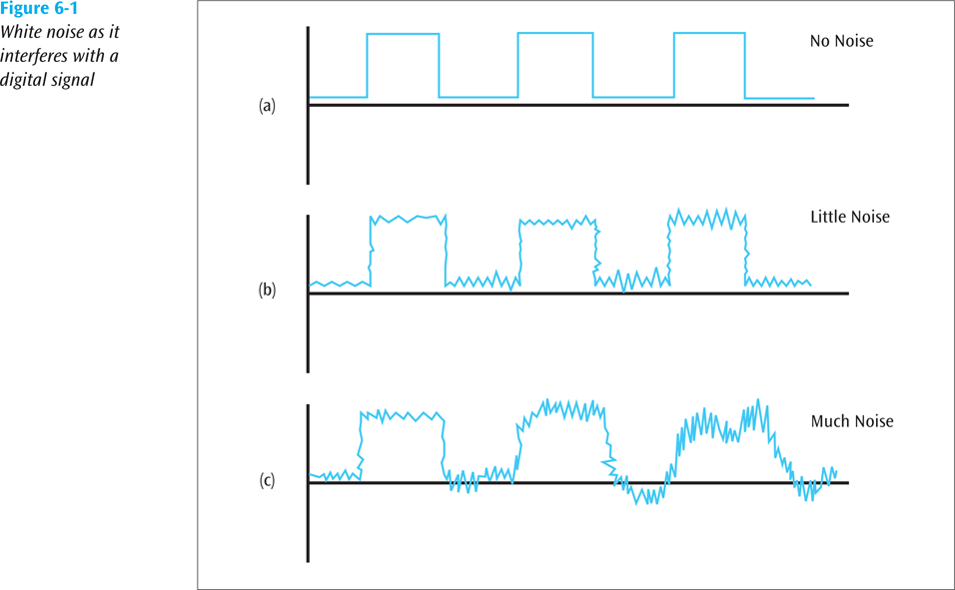
White Noise (continued)
Data Communications and Computer Networks: A Business User's Approach, Eighth Edition
© 2016. Cengage Learning. All Rights Reserved.

Slide 7
Impulse Noise
One of the most disruptive forms of noise
Random spikes of power that can destroy one or more bits of information
Difficult to remove from an analog signal because it may be hard to distinguish from the original signal
Impulse noise can damage more bits if the bits are closer together (transmitted at a faster rate)
Data Communications and Computer Networks: A Business User's Approach, Eighth Edition
© 2016. Cengage Learning. All Rights Reserved.

Slide 8
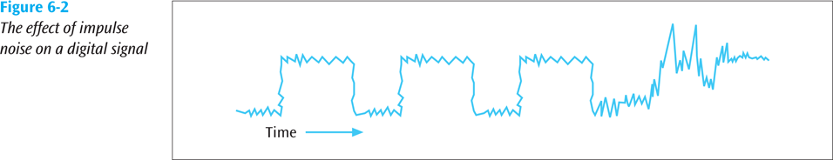
Impulse Noise (continued)
Data Communications and Computer Networks: A Business User's Approach, Eighth Edition
© 2016. Cengage Learning. All Rights Reserved.

Slide 9
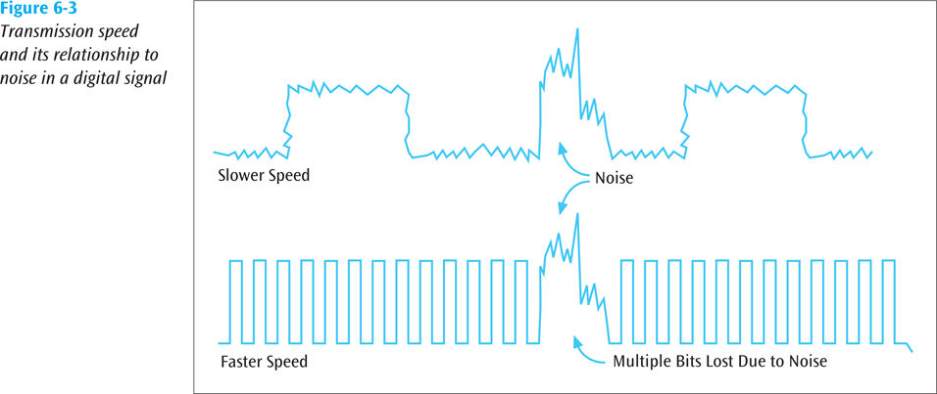
Impulse Noise (continued)
Data Communications and Computer Networks: A Business User's Approach, Eighth Edition
© 2016. Cengage Learning. All Rights Reserved.
Notes:
The bottom figure should show much more distortion, completely blowing out one or two bits of information.

Slide 10
Crosstalk
Unwanted coupling between two different signal paths
  For example, hearing another conversation while talking on the telephone
Relatively constant and can be reduced with proper measures
Data Communications and Computer Networks: A Business User's Approach, Eighth Edition
© 2016. Cengage Learning. All Rights Reserved.

Slide 11
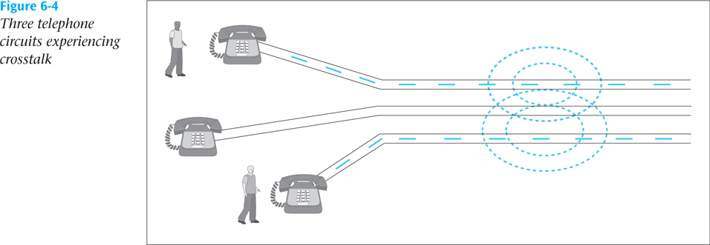
Crosstalk (continued)
Data Communications and Computer Networks: A Business User's Approach, Eighth Edition
© 2016. Cengage Learning. All Rights Reserved.

Slide 12
Echo
The reflective feedback of a transmitted signal as the signal moves through a medium
Most often occurs on coaxial cable
If echo bad enough, it could interfere with original signal
Relatively constant, and can be significantly reduced
Data Communications and Computer Networks: A Business User's Approach, Eighth Edition
© 2016. Cengage Learning. All Rights Reserved.

Slide 13
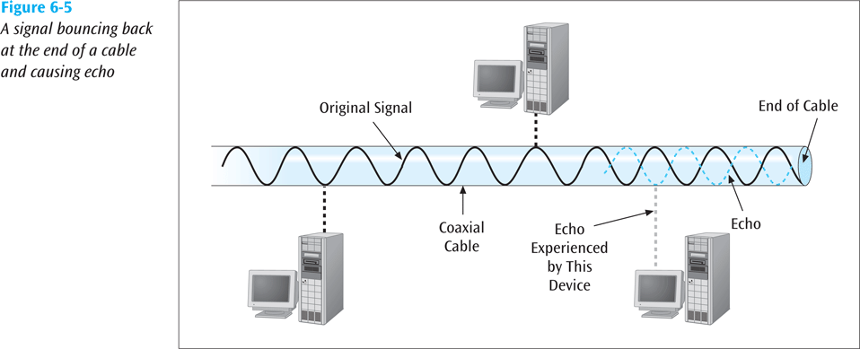
Echo (continued)
Data Communications and Computer Networks: A Business User's Approach, Eighth Edition
© 2016. Cengage Learning. All Rights Reserved.

Slide 14
Jitter
The result of small timing irregularities during the transmission of digital signals
Occurs when a digital signal is repeated over and over
If serious enough, jitter forces systems to slow down their transmission
Steps can be taken to reduce jitter
Data Communications and Computer Networks: A Business User's Approach, Eighth Edition
© 2016. Cengage Learning. All Rights Reserved.

Slide 15
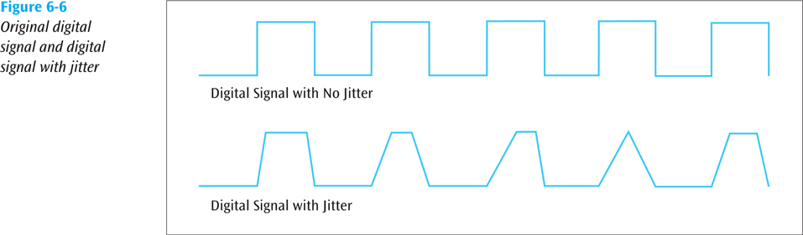
Jitter (continued)
Data Communications and Computer Networks: A Business User's Approach, Eighth Edition
© 2016. Cengage Learning. All Rights Reserved.

Slide 16
Delay Distortion
Occurs because the velocity of propagation of a signal through a medium varies with the frequency of the signal
  Can be reduced
Data Communications and Computer Networks: A Business User's Approach, Eighth Edition
© 2016. Cengage Learning. All Rights Reserved.

Slide 17
Attenuation
The continuous loss of a signal’s strength as it travels through a medium
Data Communications and Computer Networks: A Business User's Approach, Eighth Edition
© 2016. Cengage Learning. All Rights Reserved.

Slide 18
Error Prevention
To prevent errors from happening, several techniques may be applied:
  Proper shielding of cables to reduce interference
  Telephone line conditioning or equalization
  Replacing older media and equipment with new, possibly digital components
  Proper use of digital repeaters and analog amplifiers
  Observe the stated capacities of the media
Data Communications and Computer Networks: A Business User's Approach, Eighth Edition
© 2016. Cengage Learning. All Rights Reserved.

Slide 19
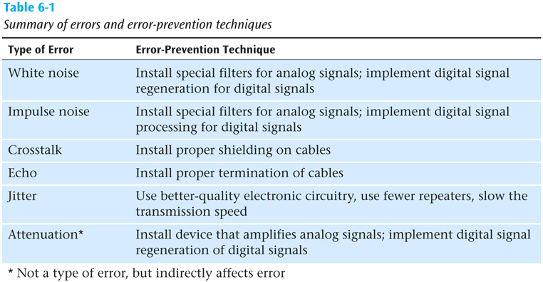
Error Prevention (continued)
Data Communications and Computer Networks: A Business User's Approach, Eighth Edition
© 2016. Cengage Learning. All Rights Reserved.

Slide 20
Error Detection
Despite the best prevention techniques, errors may still happen
To detect an error, something extra has to be added to the data/signal
  This extra is an error detection code
Three basic techniques for detecting errors: parity checking, arithmetic checksum, and cyclic redundancy checksum
Data Communications and Computer Networks: A Business User's Approach, Eighth Edition
© 2016. Cengage Learning. All Rights Reserved.

Slide 21
Parity Checks
Simple parity
  If performing even parity, add a parity bit such that an even number of 1s are maintained
  If performing odd parity, add a parity bit such that an odd number of 1s are maintained
  For example, send 1001010 using odd parity
  For example, send 1001011 using even parity
Data Communications and Computer Networks: A Business User's Approach, Eighth Edition
© 2016. Cengage Learning. All Rights Reserved.

Slide 22
Parity Checks (continued)
Simple parity (continued)
  What happens if the character 10010101 is sent and the first two 0s accidentally become two 1s?
    Thus, the following character is received: 11110101
    Will there be a parity error?
      Problem: Simple parity only detects odd numbers of bits in error
Data Communications and Computer Networks: A Business User's Approach, Eighth Edition
© 2016. Cengage Learning. All Rights Reserved.

Slide 23
Parity Checks (continued)
Longitudinal parity
  Adds a parity bit to each character then adds a row of parity bits after a block of characters
  The row of parity bits is actually a parity bit for each “column” of characters
  The row of parity bits plus the column parity bits add a great amount of redundancy to a block of characters
Data Communications and Computer Networks: A Business User's Approach, Eighth Edition
© 2016. Cengage Learning. All Rights Reserved.

Slide 24
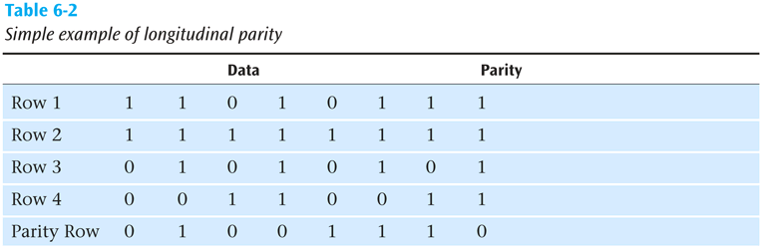
Parity Checks (continued)
Data Communications and Computer Networks: A Business User's Approach, Eighth Edition
© 2016. Cengage Learning. All Rights Reserved.

Slide 25
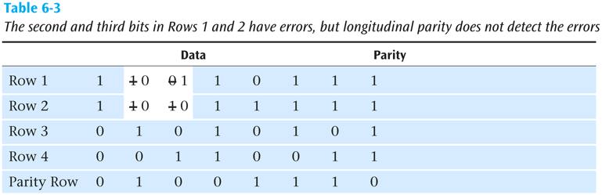
Parity Checks (continued)
Data Communications and Computer Networks: A Business User's Approach, Eighth Edition
© 2016. Cengage Learning. All Rights Reserved.

Slide 26
Parity Checks (continued)
Both simple parity and longitudinal parity do not catch all errors
Simple parity only catches odd numbers of bit errors
Longitudinal parity is better at catching errors but requires too many check bits added to a block of data
We need a better error detection method
  What about arithmetic checksum?
Data Communications and Computer Networks: A Business User's Approach, Eighth Edition
© 2016. Cengage Learning. All Rights Reserved.

Slide 27
Arithmetic Checksum
Used in TCP and IP on the Internet
Characters to be transmitted are converted to numeric form and summed
Sum is placed in some form at the end of the transmission
Data Communications and Computer Networks: A Business User's Approach, Eighth Edition
© 2016. Cengage Learning. All Rights Reserved.

Slide 28
Arithmetic Checksum
Simplified example:
56
72
34
48
210
Then bring 2 down and add to right-most position
10
2
12
Data Communications and Computer Networks: A Business User's Approach, Eighth Edition
© 2016. Cengage Learning. All Rights Reserved.

Slide 29
Arithmetic Checksum
Receiver performs same conversion and summing and compares new sum with sent sum
TCP and IP processes a little more complex but idea is the same
But even arithmetic checksum can let errors slip through. Is there something more powerful yet?
Data Communications and Computer Networks: A Business User's Approach, Eighth Edition
© 2016. Cengage Learning. All Rights Reserved.

Slide 30
Cyclic Redundancy Checksum
CRC error detection method treats the packet of data to be transmitted as a large polynomial
Transmitter takes the message polynomial and using polynomial arithmetic, divides it by a given generating polynomial
Quotient is discarded but the remainder is “attached” to the end of the message
Data Communications and Computer Networks: A Business User's Approach, Eighth Edition
© 2016. Cengage Learning. All Rights Reserved.

Slide 31
Cyclic Redundancy Checksum (continued)
The message (with the remainder) is transmitted to the receiver
The receiver divides the message and remainder by the same generating polynomial
If a remainder not equal to zero results, there was an error during transmission
If a remainder of zero results, there was no error during transmission
Data Communications and Computer Networks: A Business User's Approach, Eighth Edition
© 2016. Cengage Learning. All Rights Reserved.

Slide 32
Cyclic Redundancy Checksum (continued)
Some standard generating polynomials:
CRC-12: x¹² + x¹¹ + x³ + x² + x + 1
CRC-16: x¹⁶ + x¹⁵ + x² + 1
CRC-CCITT: x¹⁶ + x¹⁵ + x⁵ + 1
CRC-32: x³² + x²⁶ + x²³ + x²² + x¹⁶ + x¹² + x¹¹ + x¹⁰ + x⁸ + x⁷ + x⁵ + x⁴ + x² + x + 1
ATM CRC: x⁸ + x² + x + 1
Data Communications and Computer Networks: A Business User's Approach, Eighth Edition
© 2016. Cengage Learning. All Rights Reserved.

Slide 33
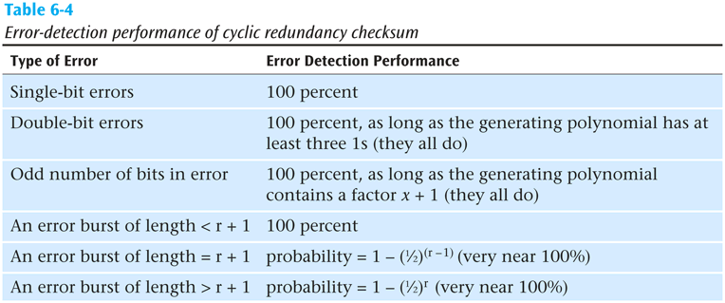
Cyclic Redundancy Checksum (continued)
Data Communications and Computer Networks: A Business User's Approach, Eighth Edition
© 2016. Cengage Learning. All Rights Reserved.

Slide 34
Error Control
Once an error is detected, what is the receiver going to do?
  Do nothing (simply toss the frame or packet)
  Return an error message to the transmitter
  Fix the error with no further help from the transmitter
Data Communications and Computer Networks: A Business User's Approach, Eighth Edition
© 2016. Cengage Learning. All Rights Reserved.

Slide 35
Do Nothing (Toss the Frame/Packet)
Seems like a strange way to control errors but some lower-layer protocols such as frame relay perform this type of error control
For example, if frame relay detects an error, it simply tosses the frame
  No message is returned
Frame relay assumes a higher protocol (such as TCP/IP) will detect the tossed frame and ask for retransmission
Data Communications and Computer Networks: A Business User's Approach, Eighth Edition
© 2016. Cengage Learning. All Rights Reserved.

Slide 36
Return A Message
Once an error is detected, an error message is returned to the transmitter
Two basic forms:
  Stop-and-wait error control
  Sliding window error control
Data Communications and Computer Networks: A Business User's Approach, Eighth Edition
© 2016. Cengage Learning. All Rights Reserved.

Slide 37
Stop-and-Wait Error Control
Stop-and-wait is the simplest of the error control protocols
A transmitter sends a frame then stops and waits for an acknowledgment
  If a positive acknowledgment (ACK) is received, the next frame is sent
  If a negative acknowledgment (NAK) is received, the same frame is transmitted again
Data Communications and Computer Networks: A Business User's Approach, Eighth Edition
© 2016. Cengage Learning. All Rights Reserved.

Slide 38
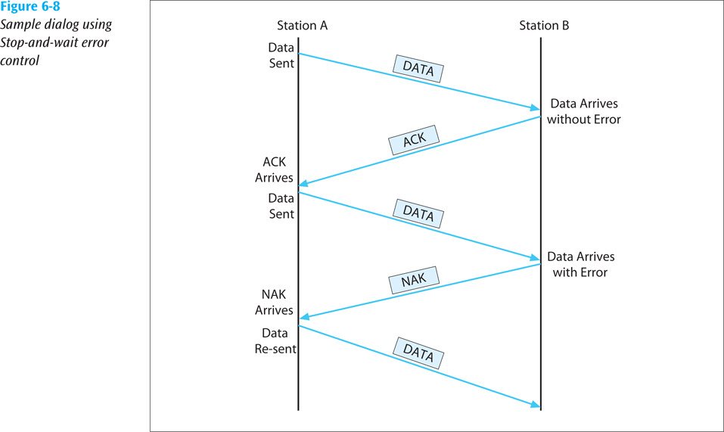
Stop-and-Wait Error Control (continued)
Data Communications and Computer Networks: A Business User's Approach, Eighth Edition
© 2016. Cengage Learning. All Rights Reserved.

Slide 39
Sliding Window Error Control
These techniques assume that multiple frames are in transmission at one time
A sliding window protocol allows the transmitter to send a number of data packets at one time before receiving any acknowledgments
  Depends on window size
When a receiver does acknowledge receipt, the returned ACK contains the number of the frame expected next
Data Communications and Computer Networks: A Business User's Approach, Eighth Edition
© 2016. Cengage Learning. All Rights Reserved.

Slide 40
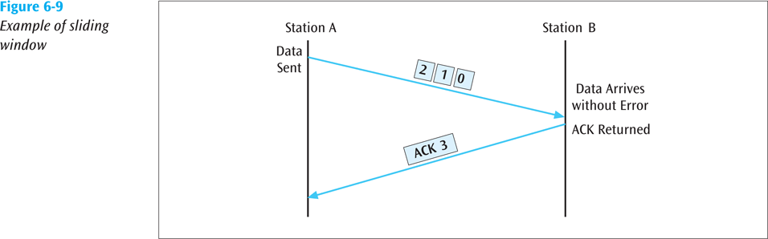
Sliding Window Error Control (continued)
Data Communications and Computer Networks: A Business User's Approach, Eighth Edition
© 2016. Cengage Learning. All Rights Reserved.

Slide 41
Sliding Window Error Control (continued)
Older sliding window protocols numbered each frame or packet that was transmitted
More modern sliding window protocols number each byte within a frame
An example in which the packets are numbered, followed by an example in which the bytes are numbered:
Data Communications and Computer Networks: A Business User's Approach, Eighth Edition
© 2016. Cengage Learning. All Rights Reserved.

Slide 42
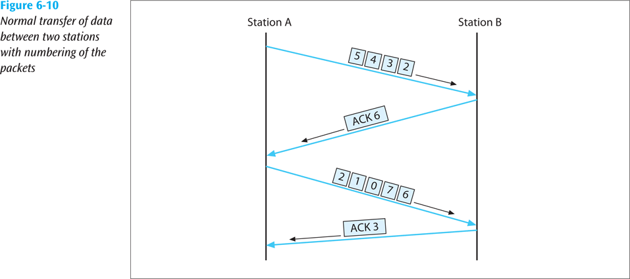
Sliding Window Error Control (continued)
Data Communications and Computer Networks: A Business User's Approach, Eighth Edition
© 2016. Cengage Learning. All Rights Reserved.

Slide 43
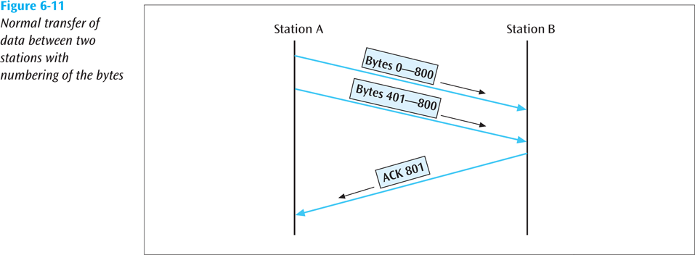
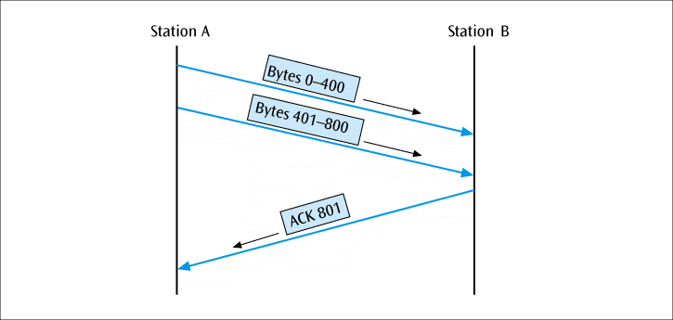
Sliding Window Error Control (continued)
Data Communications and Computer Networks: A Business User's Approach, Eighth Edition
© 2016. Cengage Learning. All Rights Reserved.

Slide 44
Sliding Window Error Control (continued)
Notice that an ACK is not always sent after each frame is received
  It is more efficient to wait for a few received frames before returning an ACK
How long should you wait until you return an ACK?
Data Communications and Computer Networks: A Business User's Approach, Eighth Edition
© 2016. Cengage Learning. All Rights Reserved.

Slide 45
Sliding Window Error Control (continued)
Using TCP/IP, there are some basic rules concerning ACKs:
  Rule 1: If a receiver just received data and wants to send its own data, piggyback an ACK along with that data
  Rule 2: If a receiver has no data to return and has just ACKed the last packet, receiver waits 500 ms for another packet
    If while waiting, another packet arrives, send the ACK immediately
  Rule 3: If a receiver has no data to return and has just ACKed the last packet, receiver waits 500 ms
    No packet, send ACK
Data Communications and Computer Networks: A Business User's Approach, Eighth Edition
© 2016. Cengage Learning. All Rights Reserved.

Slide 46
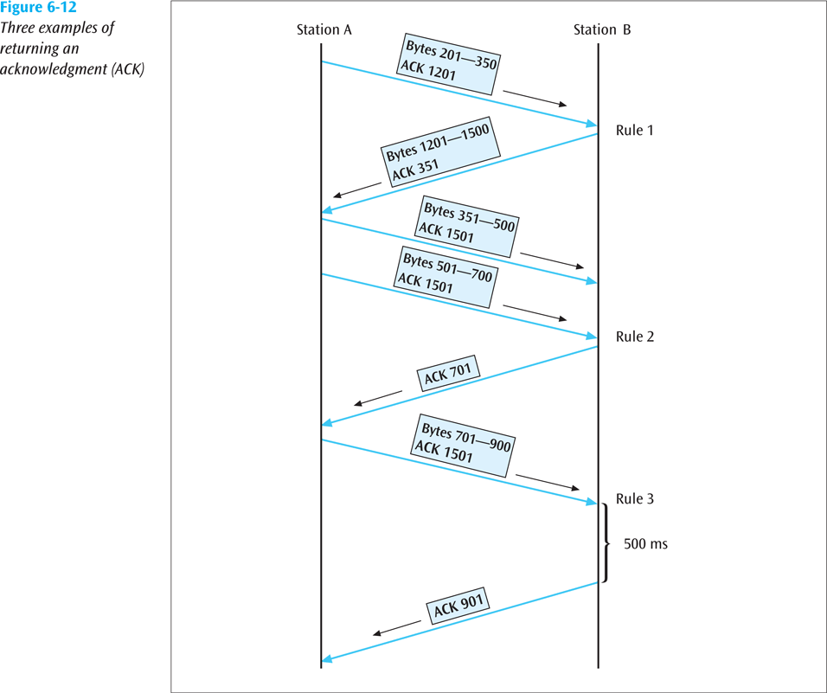
Sliding Window Error Control (continued)
Data Communications and Computer Networks: A Business User's Approach, Eighth Edition
© 2016. Cengage Learning. All Rights Reserved.

Slide 47
Sliding Window Error Control (continued)
What happens when a packet is lost?
  As shown in the next slide, if a frame is lost, the following frame will be “out of sequence”
    The receiver will hold the out of sequence bytes in a buffer and request the sender to retransmit the missing frame
Data Communications and Computer Networks: A Business User's Approach, Eighth Edition
© 2016. Cengage Learning. All Rights Reserved.

Slide 48
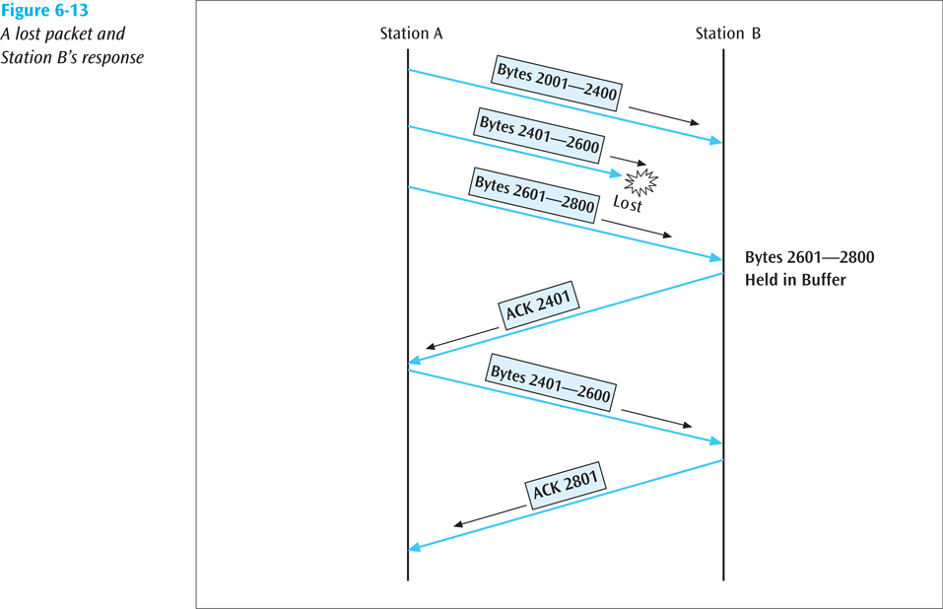
Sliding Window Error Control (continued)
Data Communications and Computer Networks: A Business User's Approach, Eighth Edition
© 2016. Cengage Learning. All Rights Reserved.

Slide 49
Sliding Window Error Control (continued)
What happens when an ACK is lost?
  As shown in the next slide, if an ACK is lost, the sender will wait for the ACK to arrive and eventually time out
    When the time-out occurs, the sender will resend the last frame
Data Communications and Computer Networks: A Business User's Approach, Eighth Edition
© 2016. Cengage Learning. All Rights Reserved.

Slide 50
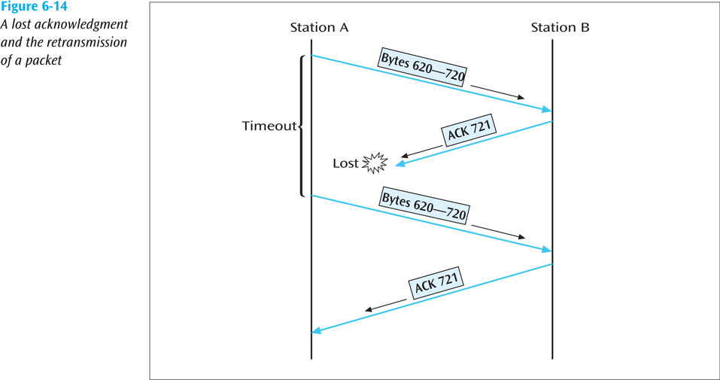
Sliding Window Error Control (continued)
Data Communications and Computer Networks: A Business User's Approach, Eighth Edition
© 2016. Cengage Learning. All Rights Reserved.

Slide 51
Correct the Error
For a receiver to correct the error with no further help from the transmitter requires a large amount of redundant information to accompany the original data
  This redundant information allows the receiver to determine the error and make corrections
This type of error control is often called forward error correction and involves codes called Hamming codes
Data Communications and Computer Networks: A Business User's Approach, Eighth Edition
© 2016. Cengage Learning. All Rights Reserved.

Slide 52
Correct the Error (continued)
Hamming codes add additional check bits to a character
  These check bits perform parity checks on various bits
Example: One could create a Hamming code in which 4 check bits are added to an 8-bit character
  We can number the check bits c8, c4, c2 and c1
  We will number the data bits b12, b11, b10, b9, b7, b6, b5, and b3
  Place the bits in the following order: b12, b11, b10, b9, c8, b7, b6, b5, c4, b3, c2, c1
Data Communications and Computer Networks: A Business User's Approach, Eighth Edition
© 2016. Cengage Learning. All Rights Reserved.

Slide 53
Correct the Error (continued)
Example (continued):
  c8 will perform a parity check on bits b12, b11, b10, and b9
  c4 will perform a parity check on bits b12, b7, b6 and b5
  c2 will perform a parity check on bits b11, b10, b7, b6 and b3
  c1 will perform a parity check on bits b11, b9, b7, b5, and b3
The next slide shows the check bits and their values
Data Communications and Computer Networks: A Business User's Approach, Eighth Edition
© 2016. Cengage Learning. All Rights Reserved.

Slide 54
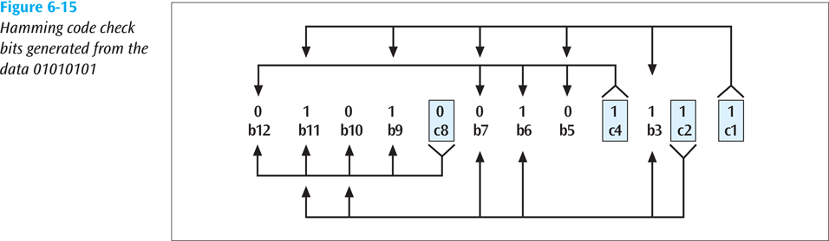
Correct the Error (continued)
Data Communications and Computer Networks: A Business User's Approach, Eighth Edition
© 2016. Cengage Learning. All Rights Reserved.

Slide 55
Correct the Error (continued)
The sender will take the 8-bit character and generate the 4 check bits as described
  The 4 check bits are then added to the 8 data bits in the sequence as shown and then transmitted
The receiver will perform the 4 parity checks using the 4 check bits
  If no bits flipped during transmission, then there should be no parity errors
What happens if one of the bits flipped during transmission?
Data Communications and Computer Networks: A Business User's Approach, Eighth Edition
© 2016. Cengage Learning. All Rights Reserved.

Slide 56
Correct the Error (continued)
For example, what if bit b9 flips?
  The c8 check bit checks bits b12, b11, b10, b9 and c8 (01000)
    This would cause a parity error
  The c4 check bit checks bits b12, b7, b6, b5 and c4 (00101)
    This would not cause a parity error (even number of 1s)
  The c2 check bit checks bits b11, b10, b7, b6, b3 and c2 (100111)
    This would not cause a parity error
Data Communications and Computer Networks: A Business User's Approach, Eighth Edition
© 2016. Cengage Learning. All Rights Reserved.

Slide 57
Correct the Error (continued)
For example, what if bit b9 flips? (continued)
  The c1 check bit checks b11, b9, b7, b5, b3 and c1 (100011)
    This would cause a parity error
  Writing the parity errors in sequence gives us 1001, which is binary for the value 9
    Thus, the bit error occurred in the 9th position
Data Communications and Computer Networks: A Business User's Approach, Eighth Edition
© 2016. Cengage Learning. All Rights Reserved.

Slide 58
Error Detection In Action
FEC is used in transmission of radio signals, such as those used in transmission of digital television (Reed-Solomon and Trellis encoding) and 4D-PAM5 (Viterbi and Trellis encoding)
Some FEC is based on Hamming Codes
Data Communications and Computer Networks: A Business User's Approach, Eighth Edition
© 2016. Cengage Learning. All Rights Reserved.

Slide 59
Summary
Noise is always present in computer networks, and if the noise level is too high, errors will be introduced during the transmission of data
  Types of noise include white noise, impulse noise, crosstalk, echo, jitter, and attenuation
Among the techniques for reducing noise are proper shielding of cables, telephone line conditioning or equalization, using modern digital equipment, using digital repeaters and analog amplifiers, and observing the stated capacities of media
Data Communications and Computer Networks: A Business User's Approach, Eighth Edition
© 2016. Cengage Learning. All Rights Reserved.

Slide 60
Summary (continued)
Three basic forms of error detection are parity, arithmetic checksum, and cyclic redundancy checksum
Cyclic redundancy checksum is a superior error-detection scheme with almost 100 percent capability of recognizing corrupted data packets
Once an error has been detected, there are three possible options: do nothing, return an error message, and correct the error
Data Communications and Computer Networks: A Business User's Approach, Eighth Edition
© 2016. Cengage Learning. All Rights Reserved.

Slide 61
Summary (continued)
Stop-and-wait protocol allows only one packet to be sent at a time
Sliding window protocol allows multiple packets to be sent at one time
Error correction is a possibility if the transmitted data contains enough redundant information so that the receiver can properly correct the error without asking the transmitter for additional information
Data Communications and Computer Networks: A Business User's Approach, Eighth Edition
© 2016. Cengage Learning. All Rights Reserved.

